Slide 1

CEIS150 Programming with Objects Final Project Johnathan Rodriguez

Slide 2
Intro
Over this eight-week course, we performed projects utilizing Replit VS Code, and provided weekly resources.
Across the next few slides, I will provide screenshots from the labs and all relevant information pertaining to each lab

Slide 3
Career Skills Obtained
Create programs using iterators and generators Python
Save application data using files.
Produce an Object-Oriented Python Programming
Skills Obtained through weekly projects:
Installation and utilization of GitHub Repository and working knowledge of VS Code through Replit Navigator
Working Knowledge and practice with creating and developing programs. Python libraries, and GUI programs for logging, graphing etc.

Slide 4

CEIS150 Module 1
Software Environment Setup

Slide 5

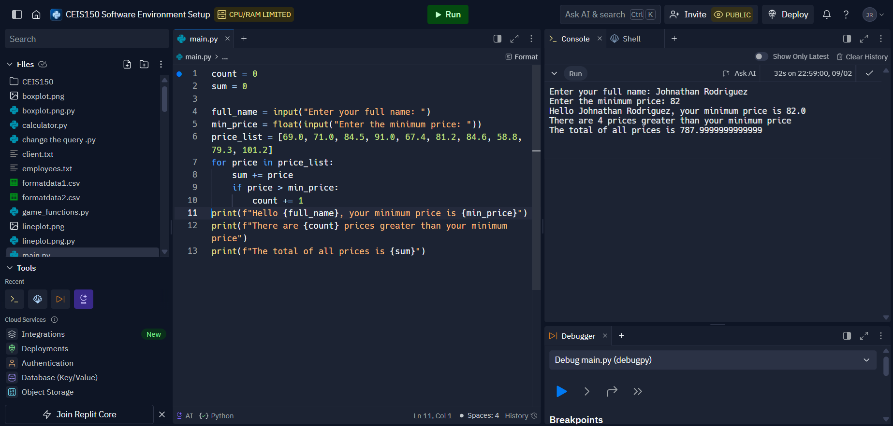
Program
Screen shot of Python program running successfully.

Slide 6

CEIS150 Module 2
Class Diagrams
Class Coding
Unit Testing

Slide 7
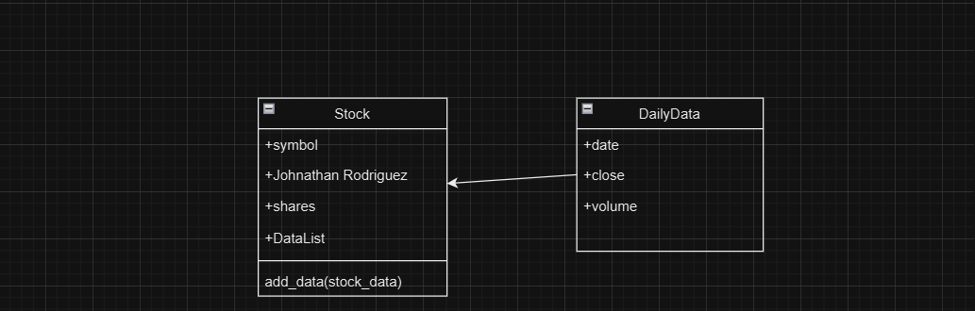
Class Diagram
Paste your Visio Class Diagram

Slide 8
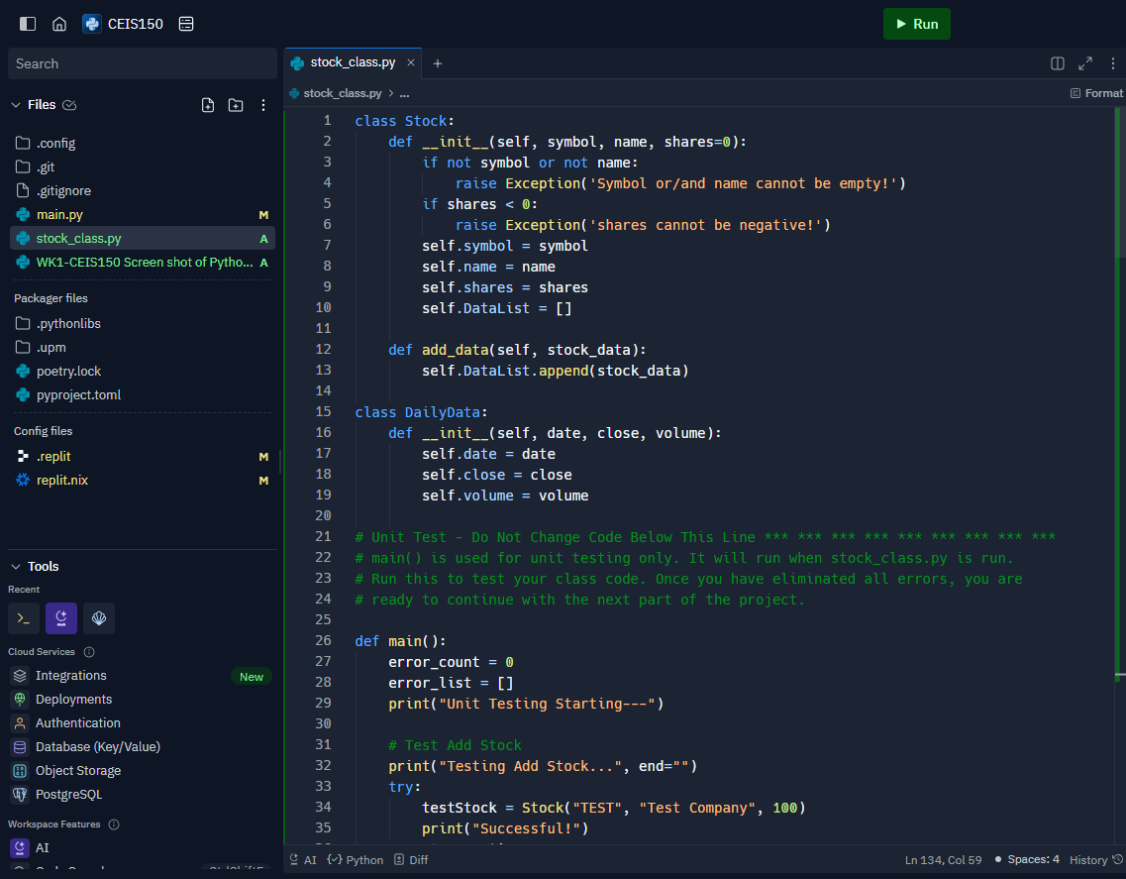
Class Code
Screen Shot of your stock_class.py file.

Slide 9
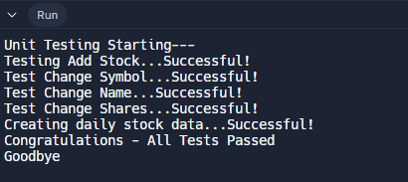
Unit Test
Screen Shot of your successful unit test.

Slide 10
CEIS150 Module 3
Text-Based User Interface
Summary Report

Slide 11
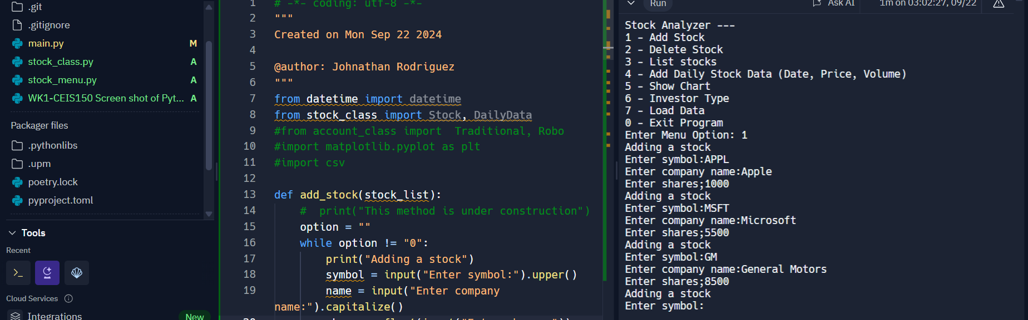
Adding a Stock
Paste a screen shot of your working Stock program.

Slide 12
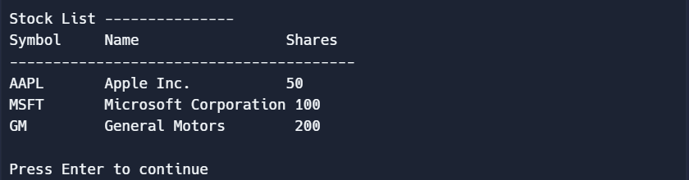
Listing 3 Stocks
Paste a screen shot of your working Stock program.

Slide 13
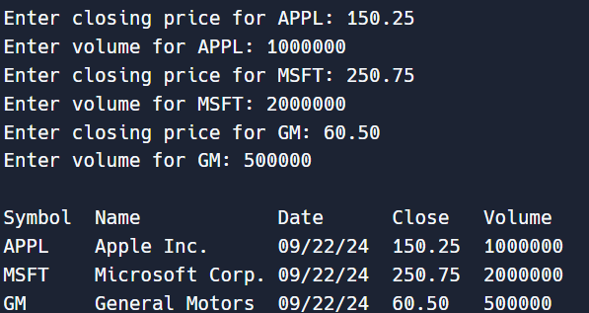
Daily Data
Paste a screen shot of your working Stock program.

Slide 14
CEIS150 Module 4
Inheritance
Summary Report

Slide 15
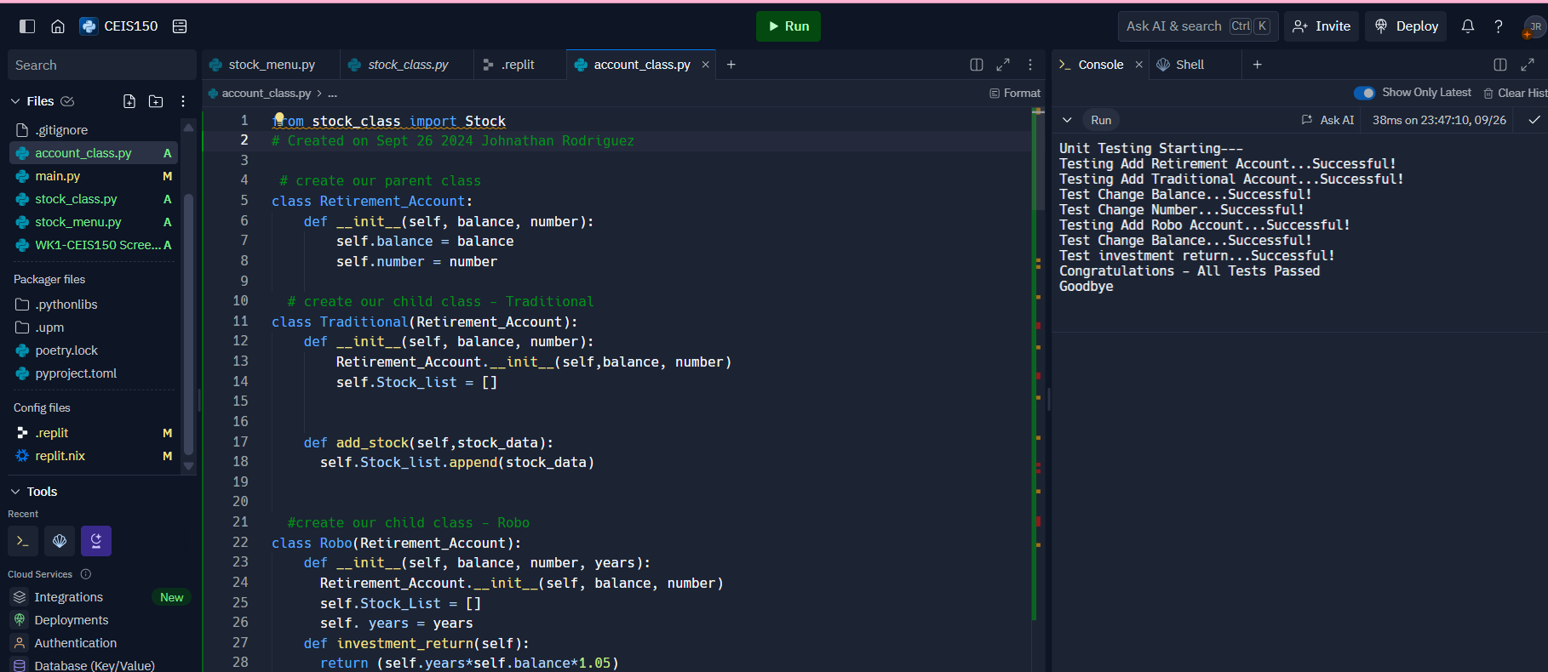
Inherited classes
Paste a screen shot of your classes

Slide 16
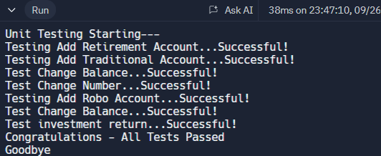
Unit Tests
Paste a screen shot of your unit tests successfully completed

Slide 17
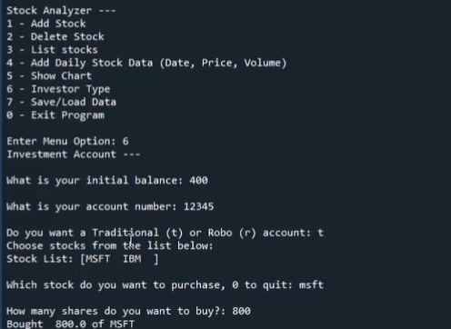
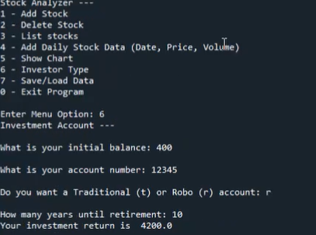
Stock menu program
Paste a screen shot of your classes in the main program

Slide 18
CEIS150 Module 5
Creating a Chart

Slide 19
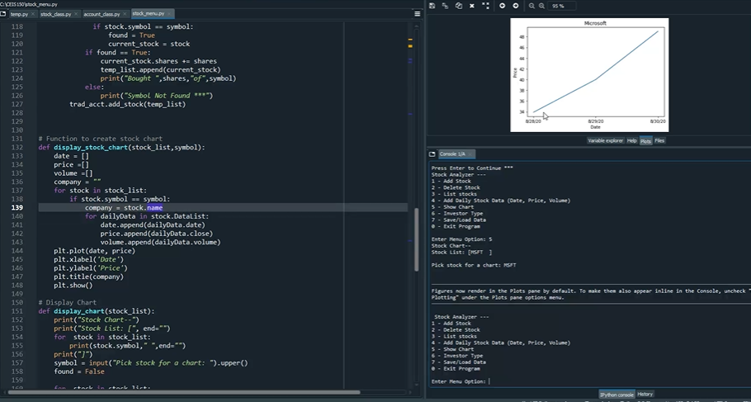
Chart
Paste a screen shot of your stock chart.

Slide 20

CEIS150 Module 6
Loading Data

Slide 21
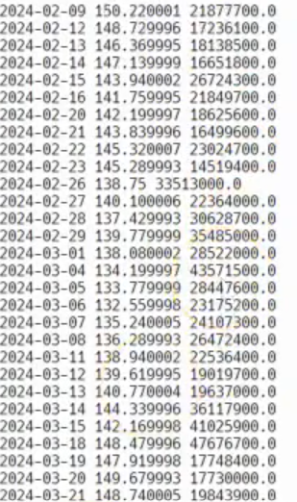
File
Paste a screen shot of the file downloaded from Yahoo finance

Slide 22
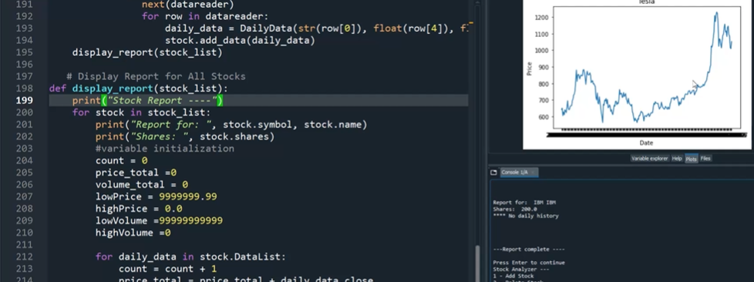
Importing data
Screenshot of the historical data import

Slide 23

CEIS150 Module 7
GUI

Slide 24

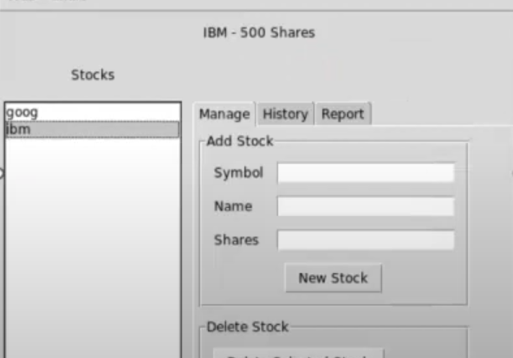
Stocks in GUI
Paste a screen shot of your GUI working

Slide 25
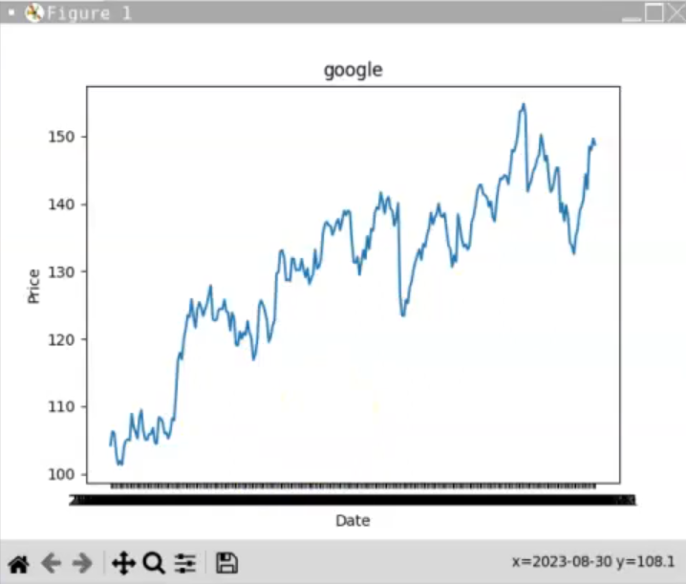
History Tab
Paste a screen shot of your History tab with import working.

Slide 26
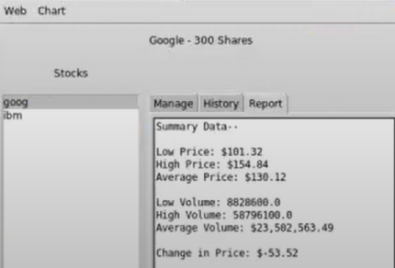
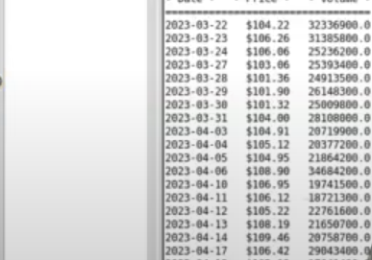
Report Complete
Paste a screen shot of your Report tab

Slide 27
Challenges Faced:
Speed Typing Code Test: Rapid coding exercises proved challenging, demanding both accuracy and swiftness. Overcoming this involved honing typing skills and refining code comprehension to ensure efficiency without sacrificing precision.
Replit Glitches: Encountering platform-specific glitches occasionally disrupted workflow. Addressing these issues required patience, platform familiarity, and troubleshooting capabilities to maintain project momentum and achieve desired outcomes.
These elements highlight the objectives and challenges intrinsic to the project, reflecting the commitment to skill development and problem-solving required for success.

